Slide 1


LAB INDIA
A Dedicated Platform
For practical knowledge

Slide 2
INSIGHTS
Web of market and proximity to consumers
Website that provides lab equipment
Multichain of retailers and manufactures of companies
Connect schools, colleges, and organizations to sellers
Quality Products With affordable prices

Slide 3

Deepak shandilya
Suvigya yadav
Yash mahajan
TEAM

Slide 4
Accelerates scientific advances and innovations
Laboratories
Enhance student’s learning
by understanding and applying the learned concepts of science
Equipped place
for experiment, research, and measurements

Slide 5
Practical knowledge
Scale
Schools
Development
Abilities
15 lakh schools &
2,500 lakh students
attain knowledge, not only theoretical but practical
magnified overall development of the human brain
understanding, grasping, and longer retention of the concepts

Slide 6

FACT – The Need Of Hour
“Everybody knows the importance of labs in science teaching but learning science has been reduced to mugging up things. Policy makers should step in immediately to rectify this situation.”
- Professor Yashpal
(scientist and former chairman of the UGC)

Slide 7
Present scenario
75% of schools in India lack fully equipped science laboratories.
In the survey of UDISE & NUEPA, out of 2.4 lakh schools, 58% of schools don’t have requisite labs.

Slide 8
Fully equipped labs (Schools)
ANDHRA PRADESH
KARNATAKA
WEST BENGAL
PUNJAB
6%
13%
6%
9%
ASSAM
4%

Slide 9
Major Drawbacks
Biggest disadvantage of the Indian education system is the lack of practical knowledge.
It curbs interest in Research and developments for future innovations.
India stands at 46th rank out of 132 economies in the Global Innovation Index (GII) 2021.
Less than 0.5% of the total students of India enroll in R&D.

Slide 10
R e a l I t y
“Many research projects have been affected. Projects cannot stop overnight, so we continue what we can with the reagents
we have. The institute is functioning at minimum running costs.”
-senior scientist
New Delhi CSIR lab
Out of 138 crores Indians, 65.1% live in rural areas, where only 28% of schools have computer labs and 9% have an Internet connection.
Only 0.7% of India’s GDP is spent on R&D, which is very little compared to other countries.

Slide 11
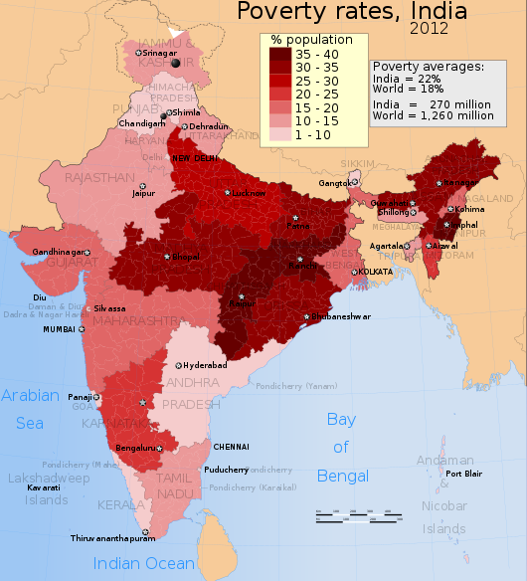

UTMOST REASON
Absence of a dedicated platform that provides lab equipment
Lack of Opportunities
No facilities in rural areas

Slide 12
A Python website using DJANGO
Ridiculously fast
Exceedingly scalable
Reassuringly secure
Clean , rapid web framework

Slide 13
FEATURES
Lab India Platform
Equipments
Opportunities
Cheap
All India
Events
community
Quick deliveries
Not only in urban but also in rural areas
Exhibitions, creative programs , webinars
People with same vision united through Chatbot
Quality cheap product among thousands of sellers

Slide 14
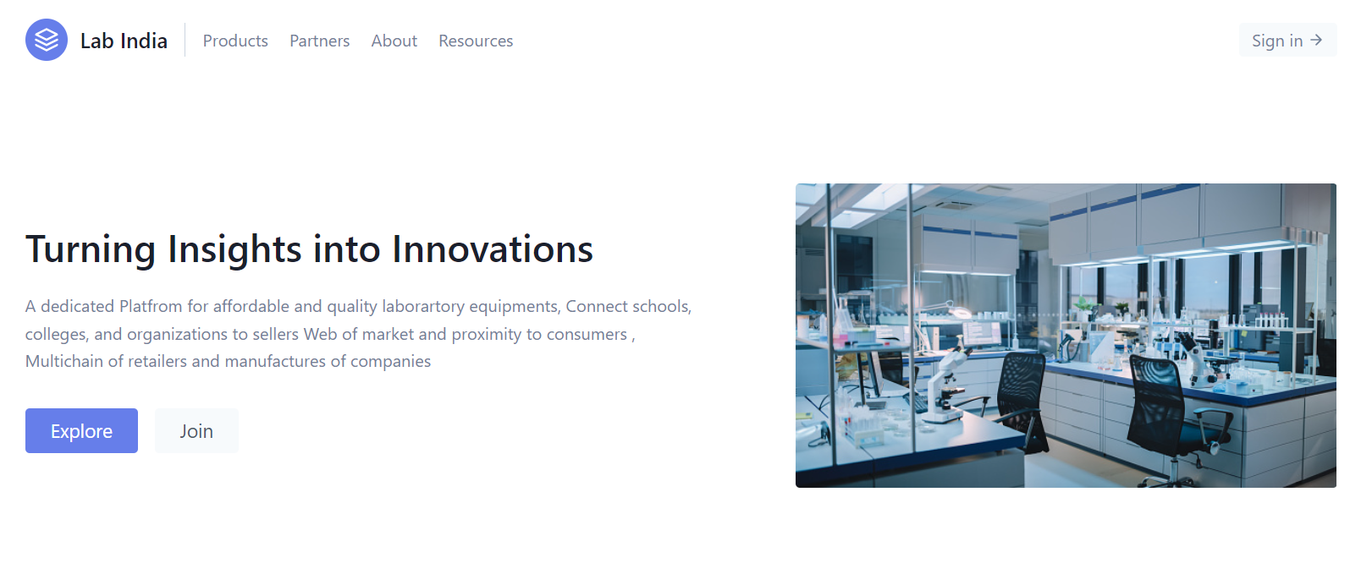
Labindia.com

Slide 15
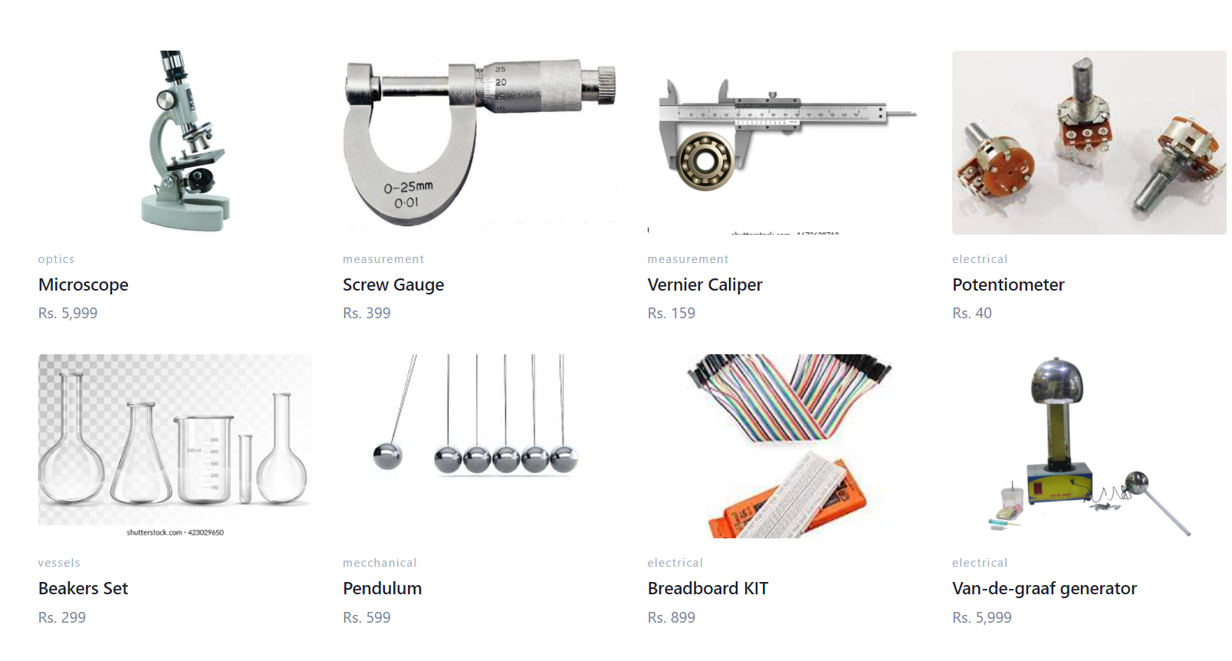
Shopping page

Slide 16

Feedback

Slide 17
THANK YOU
Hope you liked our presentation and Idea !

